Slide 1
ROCK, PAPER,
AND SCISSORS
A Mini Project Presentation
College of Information Technology Education
PHINMA – University of Iloilo | Iloilo City
Bachelor of Science in Information Technology
ITE 260 – Computer Programming 1
GROUP MEMBERS
Feliciano, Ashly Marañon
Flaviano, Ariane Cabangal
Sapeda, John Mirben Escala
Tabuada, Gerald Jone Diza
Tagulino, Kean Vhenz

Slide 2
DESCRIPTION
Introduction to the project
The Rock, Paper, Scissors Game is a simple text-based game developed using Python. The player chooses rock, paper, or scissors, while the computer randomly selects one of the three options. The program compares both choices and determines whether the player wins, loses, or ties.
ROCK
PAPER
SCISSORS
Beats scissors
Beats rock
Beats paper
If both choices are the same, the round ends in a tie. The player can replay or quit at any time.

Slide 3
OBJECTIVES
What the project aims to achieve
GENERAL OBJECTIVE
To develop a simple and interactive Rock, Paper, Scissors game using Python.
SPECIFIC OBJECTIVES
1. To allow the player to choose rock, paper, or scissors.
2. To determine the winner by comparing the player's choice with the computer's random choice.
3. To apply basic Python concepts such as input, random selection, conditional statements, and loops.

Slide 4
FLOWCHART
Rock, Paper, and Scissors Game — program flow
START
Import random module
Display welcome message
Play again?
(yes / no)
NO
END
Thank you for playing!
YES
Input: rock, paper, or scissors
After each round
Display “Invalid choice”
Ask player to try again
NO
Is the choice valid?
LEGEND
Green: Start / End Yellow: Decision
Purple: Input / Output Blue: Process
YES
Computer randomly selects a choice
Return to “Play again?”
Compare both choices
Display win, lose, or tie

Slide 5
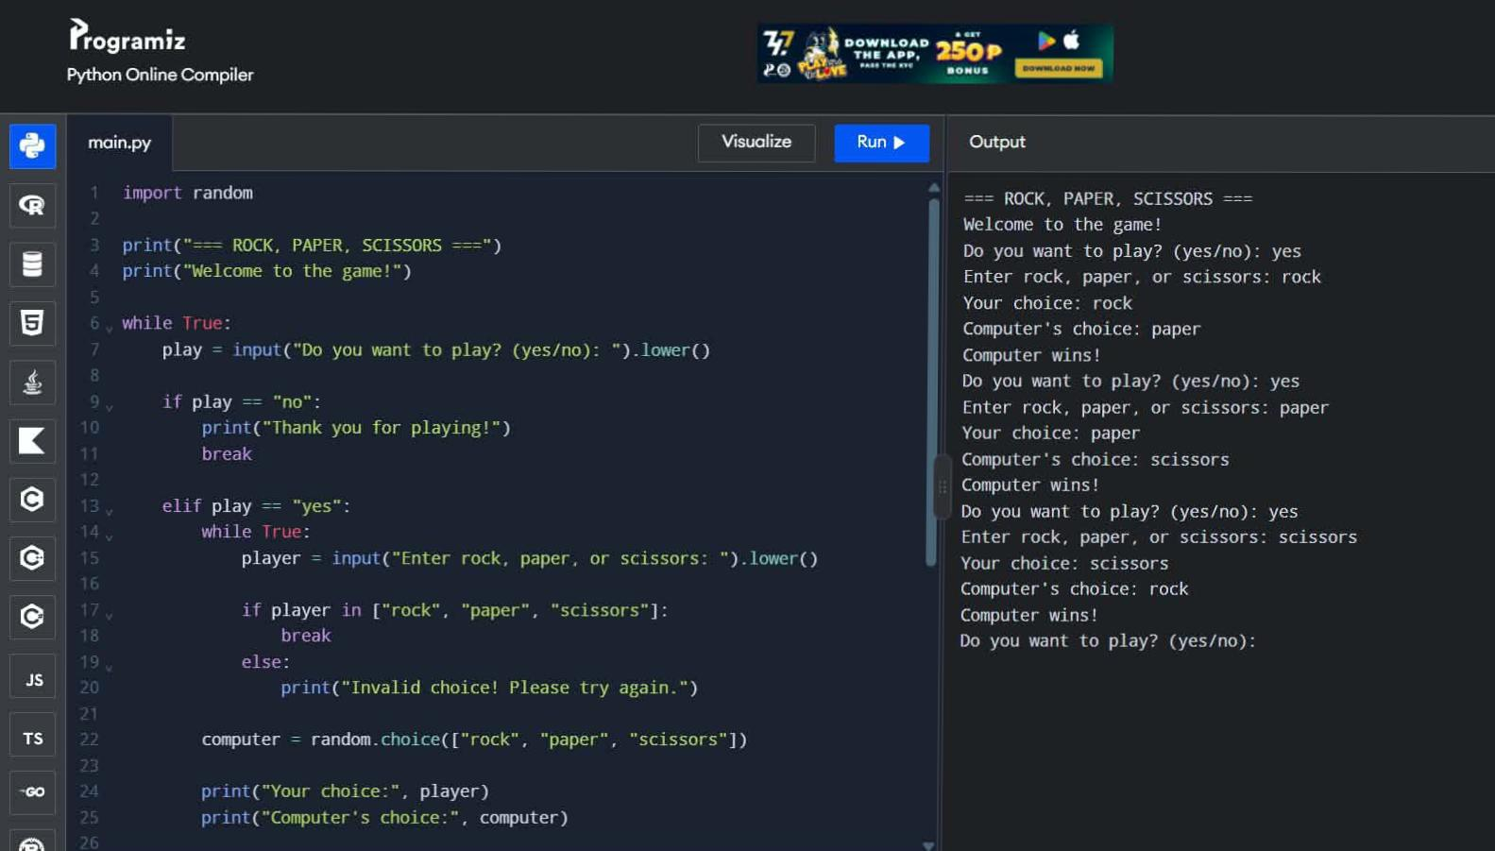
Source Code

